Slide 1
Enterprise Software Life-cycle Support System
Enterprise TFS - Software Factory NTI
Mike O’Brien, Toby Hable
August 2014

Slide 2
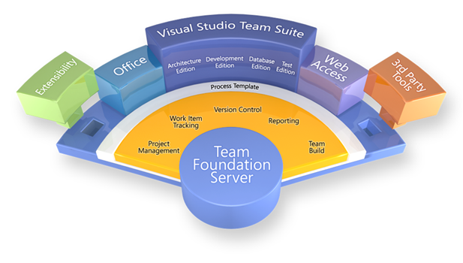
NTI-Core: Software Life-cycle Support System
Technology:
Establish a Software Life-cycle Support System (SLSS) by leveraging Microsoft Team Foundation Server (TFS).
Objectives:
Engage Microsoft Consulting
Deploy and Verify Service
Engage and Train IT Ops Team
Initiate migration of HISD Team Projects
Migration of SEMSTFS Teams
Businesses – HISD, TSSD, IPD
Status: Service Implementation (Sept – Dec)
Resources: $200 K
3.0 FTE for
Mike O’Brien 1.0 FTE
Don Carlson 0.5 FTE
New Hire for DevOps Team 1.0 FTE
DevOps Offshore resource 0.5 FTE
Dave Schaller – HISD
Scott Howard – HISD
Microsoft Consulting $180 k
Total funding request $380 K
Key SEMS Contact: Mike O’Brien

Slide 3
ETFS Timeline
HIS Target for all TFS teams migrated
Startup Investment
Service Available
All HIS teams migrated
Pre-NTI
May 5
Sept
Jan
March
March
2014
May
Jun
July
Aug
Sep
Oct
Nov
Dec
Jan
Feb
Mar
Apr
May
Jun
Define
Implementation
Ongoing
Today

Slide 4
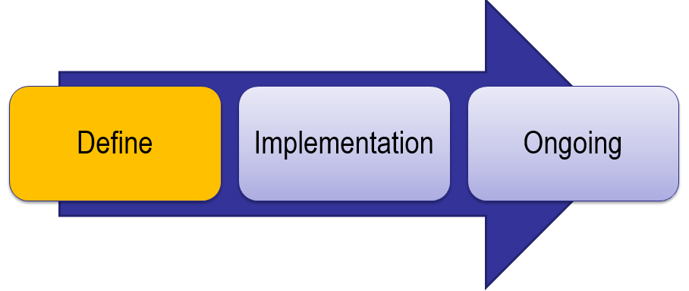
ETFS Timeline
Define Service (Done!)
System Requirements
Definition of the Service
Draft of ‘Cost of Service’
Engaged additional candidate Divisions
System Architecture
Draft of Service Level Agreement (SLA)
CTOC Presentation
Investments Made
Dedicated resource working since 5/5
Weekly update meetings with HIS
Leveraging existing IT Team for Operations
IT can manage TFS licenses
Leveraging existing 3M IT infrastructure

Slide 5
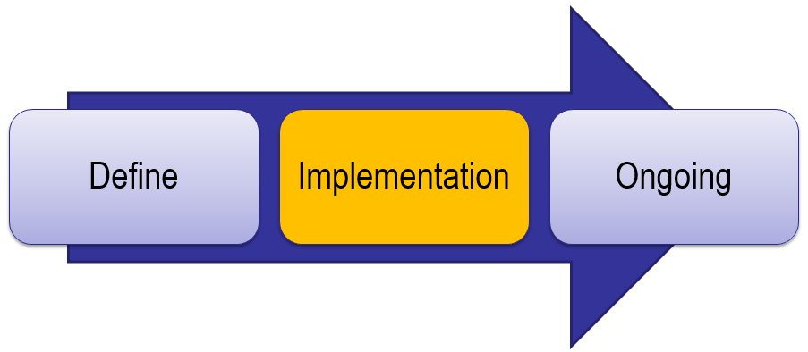
ETFS Timeline – Service Implementation
Service Implementation (Sept – Dec)
New Hire - DevOps resource
Startup cost – engage Microsoft Consulting for implementation and verification of service: $180k
IT Operations Team – support of service 24 x 7 x 365 – Train Team
Begin migration of Division Teams
Objective and Deliverable | Hours -Low | Hours -High | Rate ($) | Cost -Low | Cost -High
TFS Infrastructure Planning and Validation
- TFS Usage Scenarios | 40 | 40 | 300 | $ 12,000 | $ 12,000
- TFS Infrastructure Plan | 24 | 24 | 300 | $ 7,200 | $ 7,200
- TFS Administration | 40 | 60 | 300 | $ 12,000 | $ 18,000
- TFS Installation Assistance including integrations ( Low estimate is for just the installation verification) | 20 | 80 | 300 | $ 6,000 | $ 24,000
- Architect/EM oversight | 24 | 40 | 340 | $ 8,160 | $ 13,600
Total | 148 | 244 |  | $ 45,360 | $ 74,800
TFS as a Service - Governance
- Shared Service Security Planning | 40 | 80 | 300 | $ 12,000 | $ 24,000
- Process Governance | 40 | 80 | 300 | $ 12,000 | $ 24,000
- Build Service Governance | 40 | 40 | 300 | $ 12,000 | $ 12,000
- Integration and Reporting Governance | 40 | 40 | 300 | $ 12,000 | $ 12,000
- Architect/EM oversight | 32 | 48 | 340 | $ 10,880 | $ 16,320
Total | 192 | 288 |  | $ 58,880 | $ 88,320
TFS as a Service - Team Onboarding
- Team on boarding process | 40 | 80 | 300 | $ 12,000 | $ 24,000
- Source Code Migration Strategy | 40 | 40 | 300 | $ 12,000 | $ 12,000
- Pilot Team on boarding assistance | 120 | 200 | 300 | $ 36,000 | $ 60,000
- Architect/EM oversight | 40 | 64 | 340 | $ 13,600 | $ 21,760
Total | 240 | 384 |  | $ 73,600 | $ 117,760
Grand total* | 580 | 916 |  | $ 177,840 | $ 280,880

Slide 6
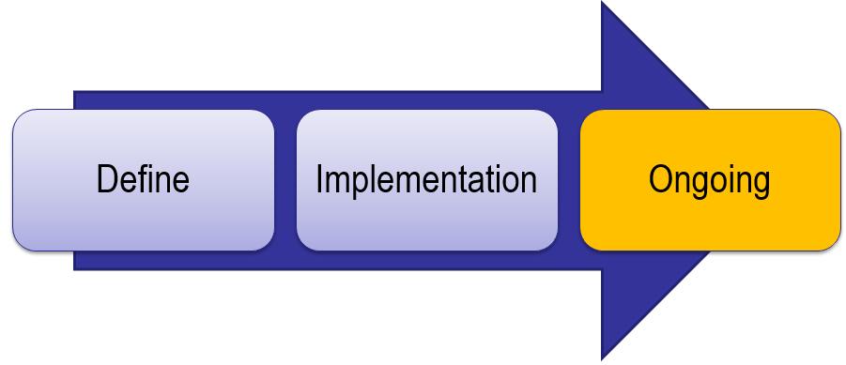
ETFS Timeline
Ongoing Service (Jan 2015 – Future)
Service available – open to all divisions/business groups/teams
$10/user per month
IT Operations Team cost
Assumes no additional resources needed
Time & Material for Custom work (by DevOps Team)
New Team Onboarding - Migration and Training
Integrations
Extension to existing ETFS

Slide 7
ETFS Timeline – Ongoing Costs
# Ops Resources | Cost / Resource | # Service Manager Resources | Cost / Resource | Total Labor | Total Team Size | Monthly Infrastructure Cost | Total Cost | Number of Users | Annual Charge per User | Monthly Cost/User
1 | 90,000 | 0.25 | 200,000 | 140,000 | 1.25 | $1,500 | 141,500 | 100 | $1,415.00 | $117.92
1 | 90,000 | 0.25 | 200,000 | 140,000 | 1.25 | $1,500 | 141,500 | 200 | $707.50 | $58.96
1 | 90,000 | 0.25 | 200,000 | 140,000 | 1.25 | $1,500 | 141,500 | 300 | $471.67 | $39.31
1 | 90,000 | 0.25 | 200,000 | 140,000 | 1.25 | $1,500 | 141,500 | 400 | $353.75 | $29.48
1 | 90,000 | 0.25 | 200,000 | 140,000 | 1.25 | $1,500 | 141,500 | 500 | $283.00 | $23.58
1 | 90,000 | 0.25 | 200,000 | 140,000 | 1.25 | $1,500 | 141,500 | 600 | $235.83 | $19.65
1 | 90,000 | 0.25 | 200,000 | 140,000 | 1.25 | $1,500 | 141,500 | 700 | $202.14 | $16.85
1 | 90,000 | 0.25 | 200,000 | 140,000 | 1.25 | $1,500 | 141,500 | 800 | $176.88 | $14.74
1 | 90,000 | 0.25 | 200,000 | 140,000 | 1.25 | $1,500 | 141,500 | 900 | $157.22 | $13.10
1 | 90,000 | 0.25 | 200,000 | 140,000 | 1.25 | $1,500 | 141,500 | 1000 | $141.50 | $11.79
1 | 90,000 | 0.25 | 200,000 | 140,000 | 1.25 | $1,500 | 141,500 | 1100 | $128.64 | $10.72
1 | 90,000 | 0.25 | 200,000 | 140,000 | 1.25 | $1,500 | 141,500 | 1200 | $117.92 | $9.83
1 | 90,000 | 0.25 | 200,000 | 140,000 | 1.25 | $1,500 | 141,500 | 1300 | $108.85 | $9.07
1 | 90,000 | 0.25 | 200,000 | 140,000 | 1.25 | $1,500 | 141,500 | 1400 | $101.07 | $8.42
1 | 90,000 | 0.25 | 200,000 | 140,000 | 1.25 | $1,500 | 141,500 | 1500 | $94.33 | $7.86
1 | 90,000 | 0.25 | 200,000 | 140,000 | 1.25 | $1,500 | 141,500 | 1600 | $88.44 | $7.37
1 | 90,000 | 0.25 | 200,000 | 140,000 | 1.25 | $1,500 | 141,500 | 1700 | $83.24 | $6.94
1 | 90,000 | 0.25 | 200,000 | 140,000 | 1.25 | $1,500 | 141,500 | 1800 | $78.61 | $6.55
1 | 90,000 | 0.25 | 200,000 | 140,000 | 1.25 | $1,500 | 141,500 | 1900 | $74.47 | $6.21
1 | 90,000 | 0.25 | 200,000 | 140,000 | 1.25 | $1,500 | 141,500 | 2000 | $70.75 | $5.90

Slide 8
ETFS Team Structure
Service Manager
- Initial contact of new teams
- Provide training
- Maintain relationship with teams
Operations (Ops)
- IT Operations Team (Managed Infrastructure)
DevOps
- Team onboarding tasks
- Service enhancements
- Test updates/upgrades, update documentation
- Perform DevOps role for SEMS/Division teams
- ETFS System Maintenance
- Respond to support requests
- Focused on PROD system

Slide 9
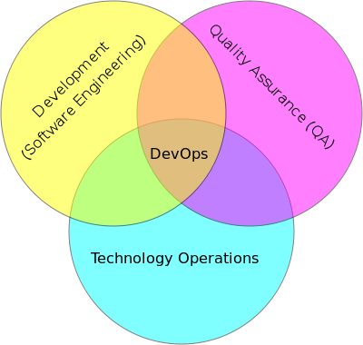
New Hire for DevOps
Role / Responsibilities:
ETFS - Team onboarding tasks
Migration of project artifacts to ETFS
Configure build services
ETFS - Service enhancements
Deploy automated build, test, and deploy systems
Non-Windows Builds, e.g, iOS / Android
3rd party Source repo – offsite source depot
SEMS - Perform DevOps role for SEMS/Division teams

Slide 10
Recommendations for ES Workgroup
Fund ETFS and eliminate user chargeback
Create “Software Developer Center of Excellence”
Coordinate training, demos, etc.. across groups/divisions
Provide “JumpStart” for software projects – process training, templates, app lifecycle recommendations
Communicate software teams successes and learnings – what works, what’s not
License purchasing coordination – purchase in volume
Rollup reporting across projects & divisions – insights into improvement

Slide 11
Task Timeline
Service Available
Jan
Aug | Sep | Oct | Nov | Dec | Jan | Feb | Mar | Apr | May | Jun | July
Cost
Migration Tool Investigation
Install QA/PROD
IT Ops Team Training
Build Team Onboarding Queue
Onboard HIS Teams
Onboard SEMSTFS teams

Slide 12
Setup Investment
Objective and Deliverable | Hours -Low | Hours -High | Rate ($) | Cost -Low | Cost -High
TFS Infrastructure Planning and Validation
- TFS Usage Scenarios | 40 | 40 | 300 | $ 12,000 | $ 12,000
- TFS Infrastructure Plan | 24 | 24 | 300 | $ 7,200 | $ 7,200
- TFS Administration | 40 | 60 | 300 | $ 12,000 | $ 18,000
- TFS Installation Assistance including integrations ( Low estimate is for just the installation verification) | 20 | 80 | 300 | $ 6,000 | $ 24,000
- Architect/EM oversight | 24 | 40 | 340 | $ 8,160 | $ 13,600
Total | 148 | 244 |  | $ 45,360 | $ 74,800
TFS as a Service - Governance
- Shared Service Security Planning | 40 | 80 | 300 | $ 12,000 | $ 24,000
- Process Governance | 40 | 80 | 300 | $ 12,000 | $ 24,000
- Build Service Governance | 40 | 40 | 300 | $ 12,000 | $ 12,000
- Integration and Reporting Governance | 40 | 40 | 300 | $ 12,000 | $ 12,000
- Architect/EM oversight | 32 | 48 | 340 | $ 10,880 | $ 16,320
Total | 192 | 288 |  | $ 58,880 | $ 88,320
TFS as a Service - Team Onboarding
- Team on boarding process | 40 | 80 | 300 | $ 12,000 | $ 24,000
- Source Code Migration Strategy | 40 | 40 | 300 | $ 12,000 | $ 12,000
- Pilot Team on boarding assistance | 120 | 200 | 300 | $ 36,000 | $ 60,000
- Architect/EM oversight | 40 | 64 | 340 | $ 13,600 | $ 21,760
Total | 240 | 384 |  | $ 73,600 | $ 117,760
Grand total* | 580 | 916 |  | $ 177,840 | $ 280,880
Startup cost – bring in Microsoft Consulting for implementation and consultation of service setup and verification: $180k

Slide 13
Technology Platform and Roadmap
Requirements
Authoring Requirements document with Enterprise defined structure, methodology, and process
Cloud Hybridization
Cross Platform Builds
(iOS / Xamarian / Android / Linux)
Rollup Reporting
(self-service reporting portal)
Value Added
DevOps
Automated build, deploy and testing harnesses
Enterprise Software Development Process
Process Template
Project Management
Requirements Management
Version Control
Test Case Management
Build Automation
Reporting
TFS Technology
Platform
TFS

Slide 14
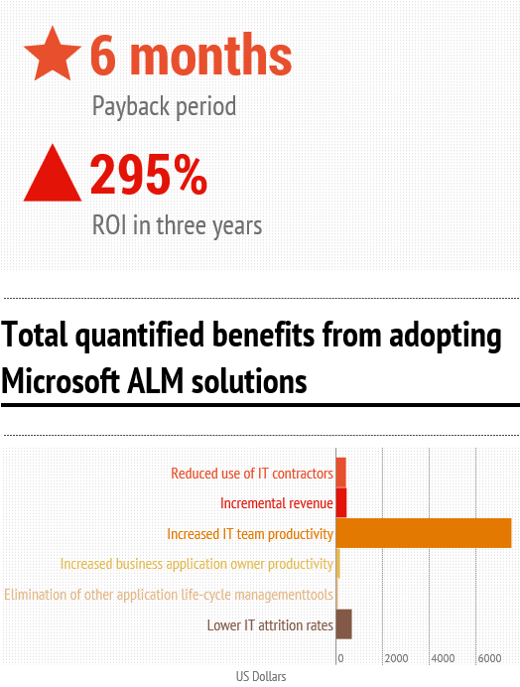
Benefits of Enterprise TFS Solution
Centralized Repository
High Availability
Improved Disaster Recovery
Increased collaboration/sharing
Reduced cost
Support Specialists – customization, maintenance and support
Visibility – customized Key Performance Indicators (KPI’s)
Training – increased knowledge of capabilities
Infography created by InCycle Software
Source information from Forrester: The Total, Economic Impact of Microsoft Application Life Cycle Mangement
Notes:
Dell case study – ROI: 225% Payback: 6 months
CollabNet case study: ROI 225% Payback: 12 months
Key benefits from case studies?

